Slide 1
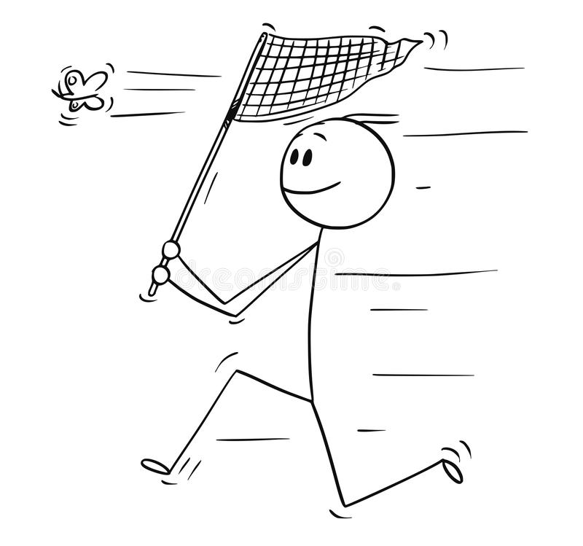
FIELD PREP 2022
Julian Wittische – Alain Frantz 2022
All photos are from Steven Falk https://www.flickr.com/photos/63075200@N07/collections/72157631518508520

Slide 2
Andrena cineraria – Summary
Males VS Females:
Females have broad dorsal stripes of dense white/grey hair at the anterior and posterior parts of the thorax and black hair in between. Legs are thick and black. Shorter antennae, barely longer that head width.
Males have denser white hairs on the side of the thorax but uniformly and more sparsely distributed white hairs on the dorsal part. Males are smaller and slimmer. Legs are thin and may some white hairs. Longer antennae, substantially larger that head width.
cineraria vs vaga:
AC females have a shiny black abdomen and AV have patches or white hair.

Slide 3
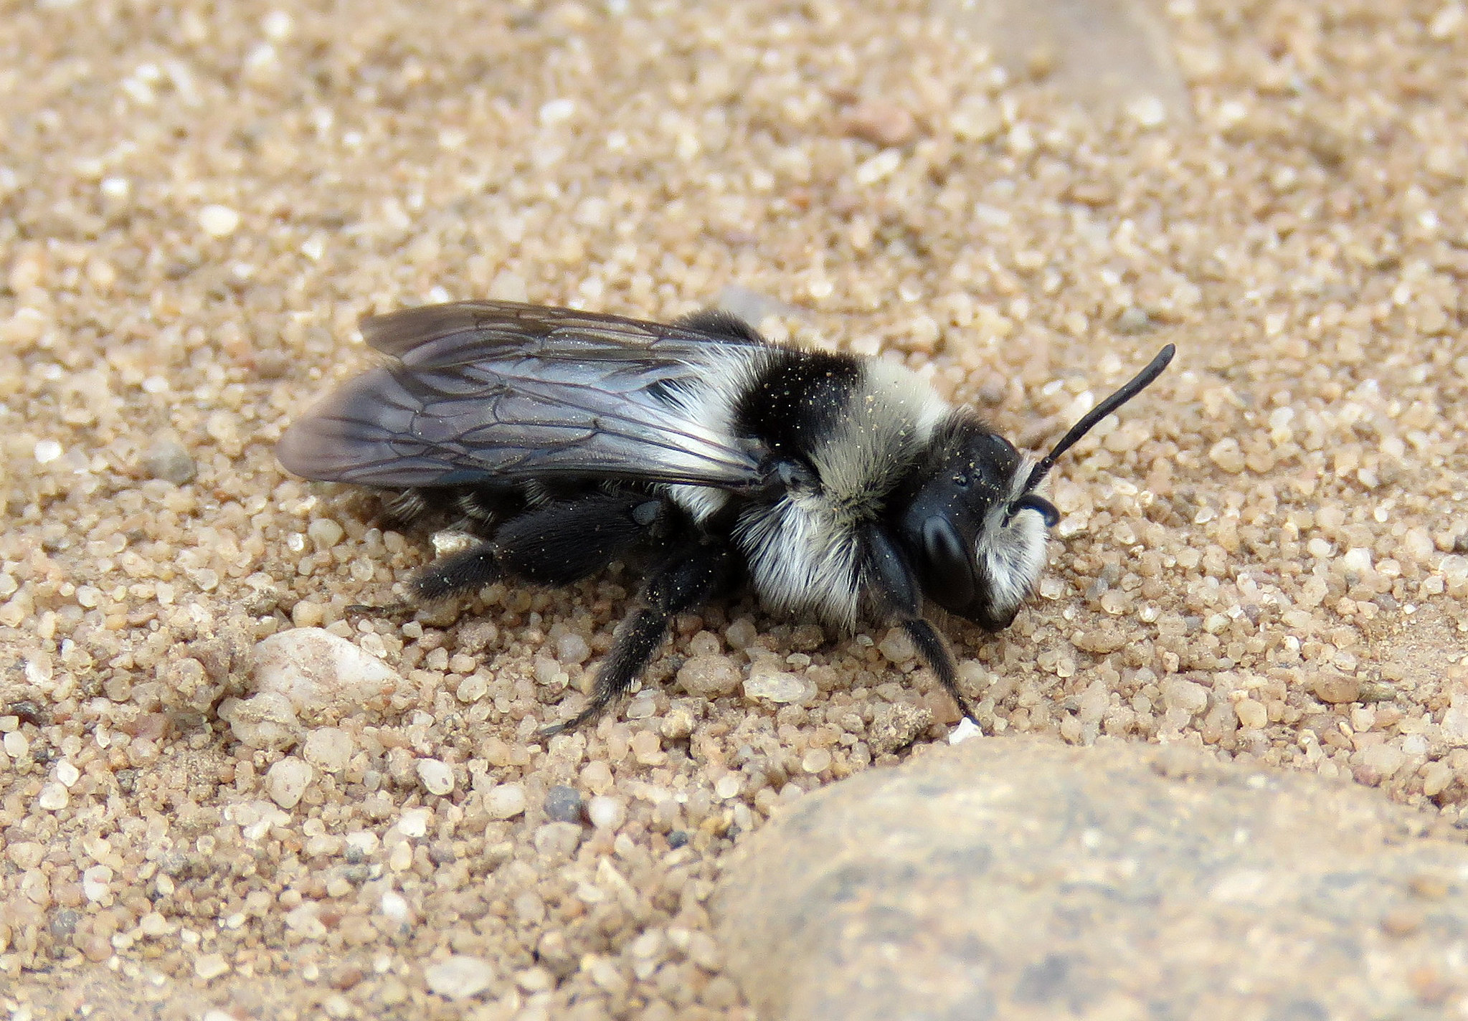
Andrena cineraria - Quiz

Slide 4
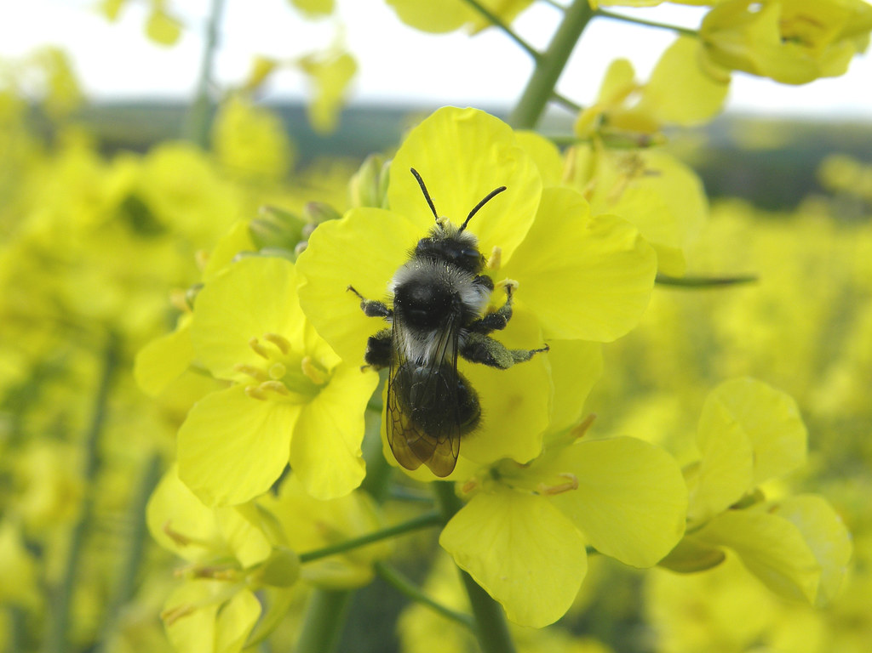
Andrena cineraria - Quiz

Slide 5
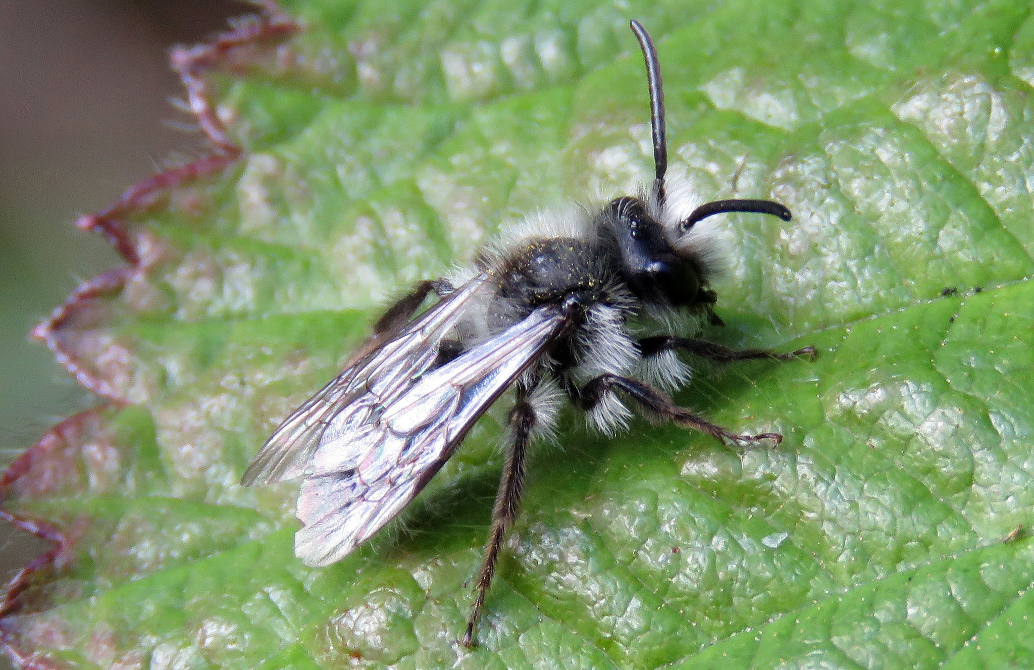
Andrena cineraria - Quiz

Slide 6
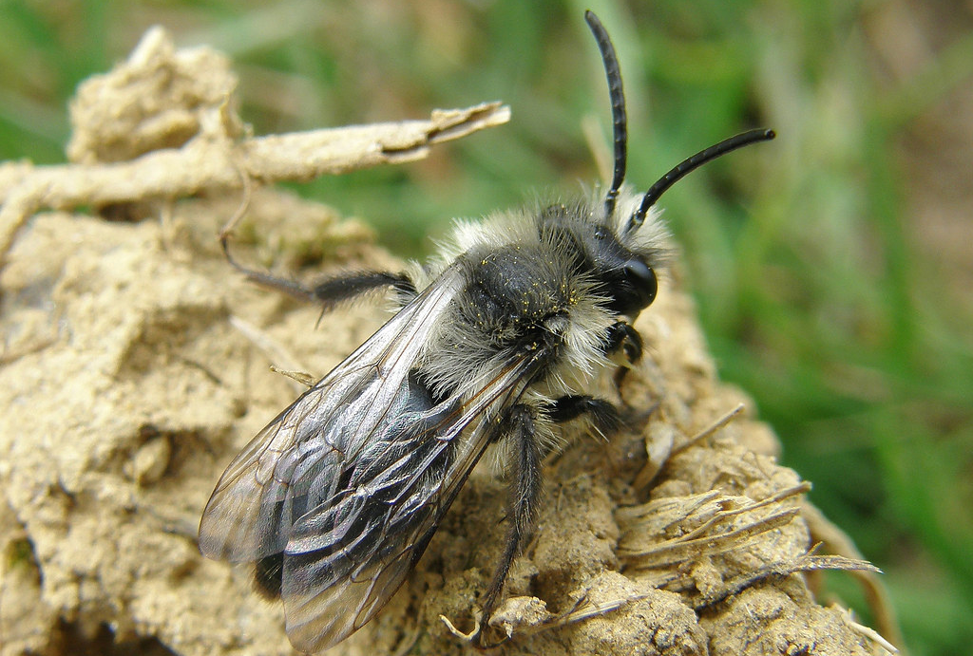
Andrena cineraria - Quiz

Slide 7
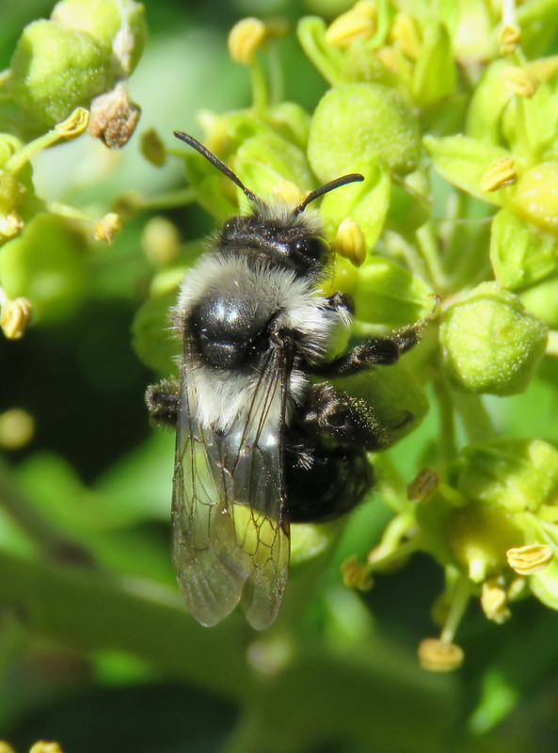
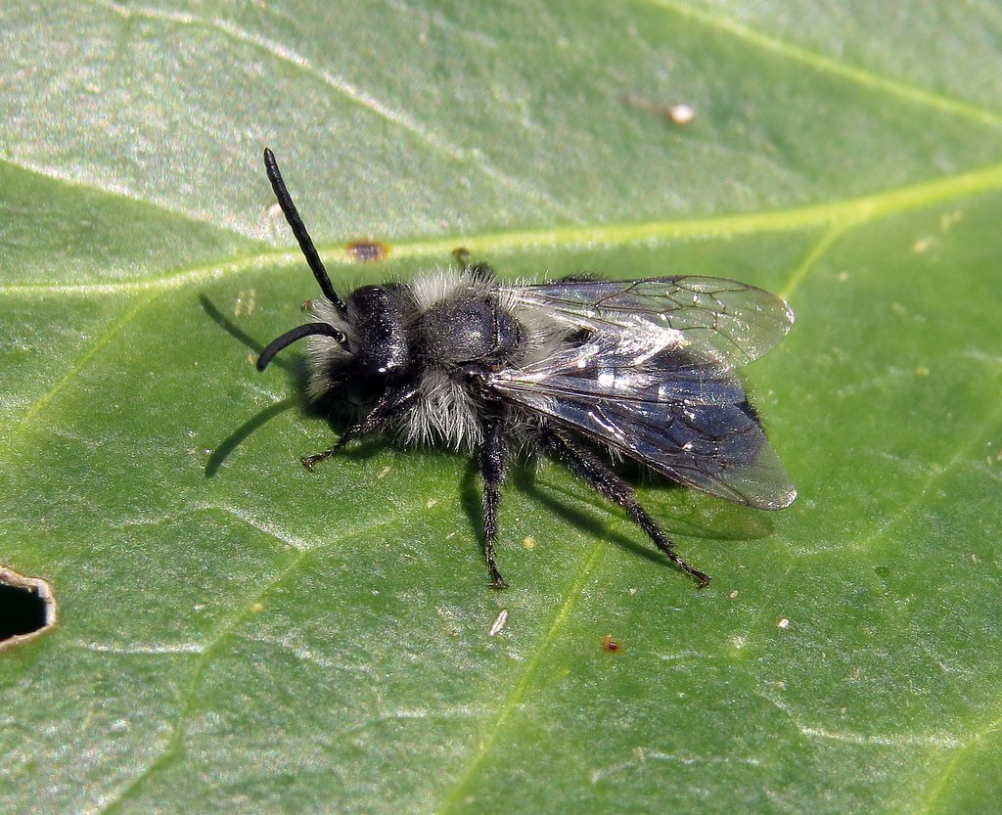
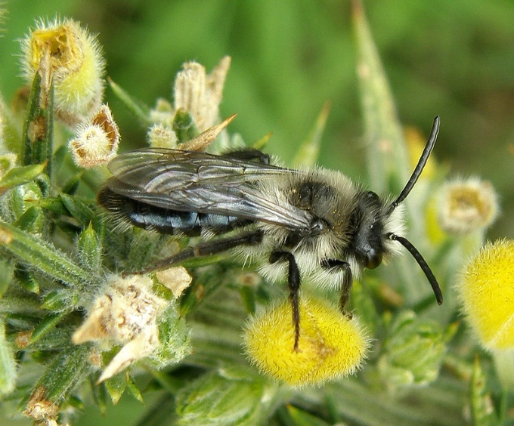
Andrena cineraria - Quiz

Slide 8
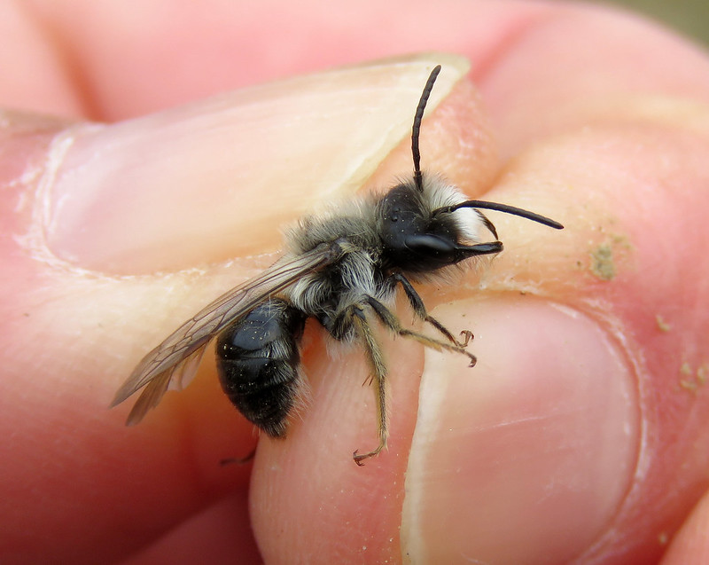
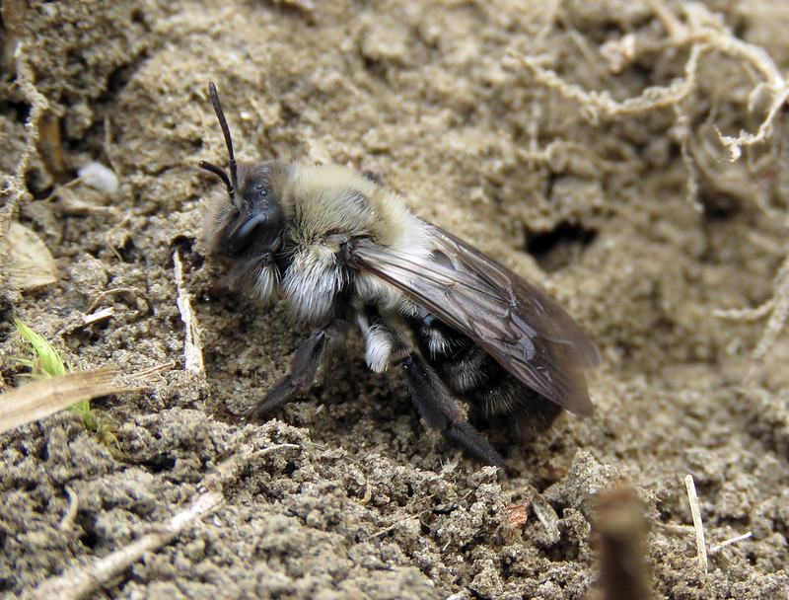
Andrena cineraria - Quiz

Slide 9
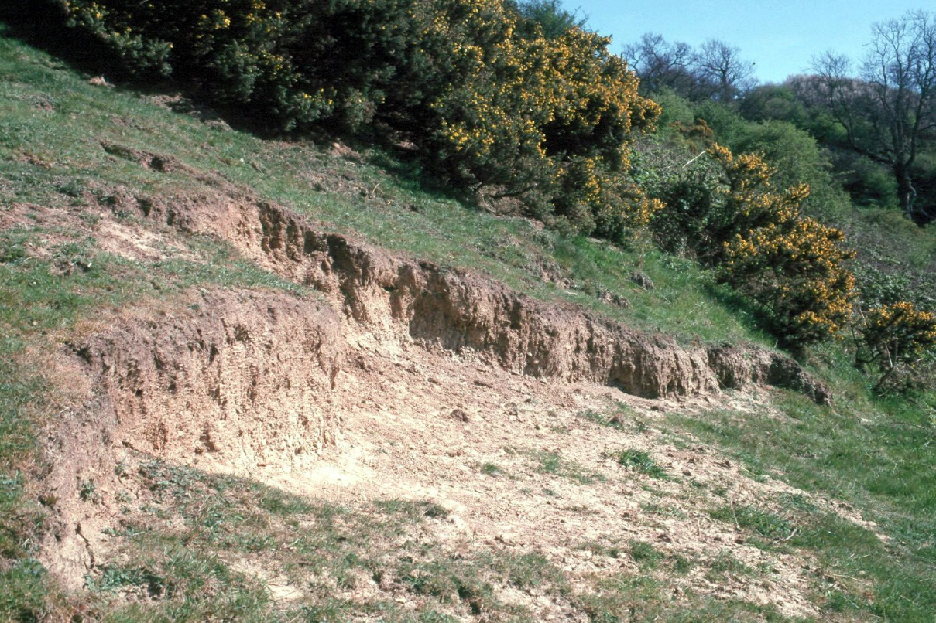
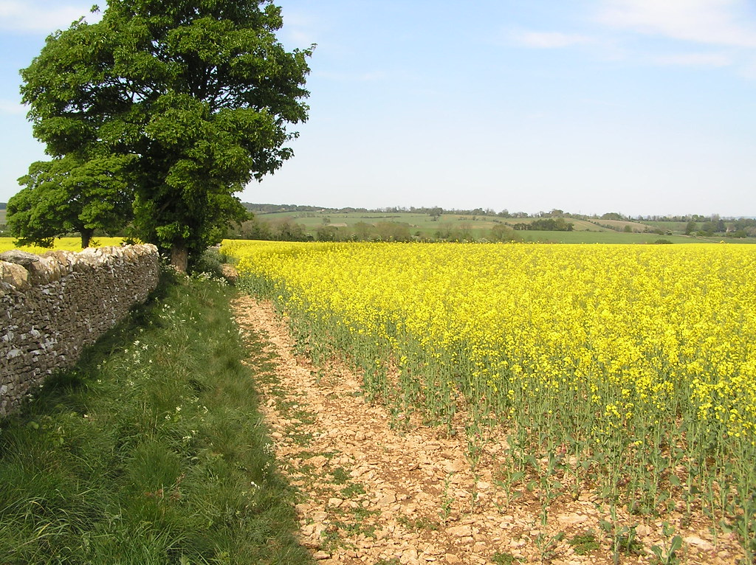
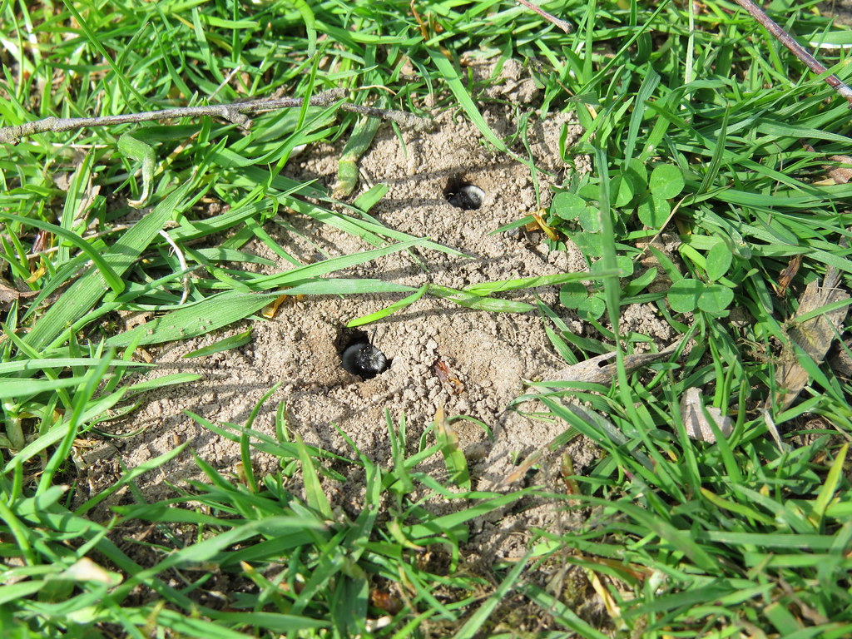
Andrena - Where to find them?

Slide 10
Osmia – Summary
Males VS Females:
Females have horns and black faces whereas males have light-colored facial hairs for O. bicornis and white hair for O. cornuta.
Males have much longer antennae (almost 2x head width) than females. Females have a pollen pouch/basket on the hind legs. Males are smaller and slimmer. O. cornuta males have a distinctly white patch of hair on the face.

Slide 11
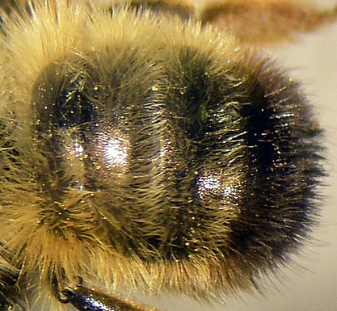
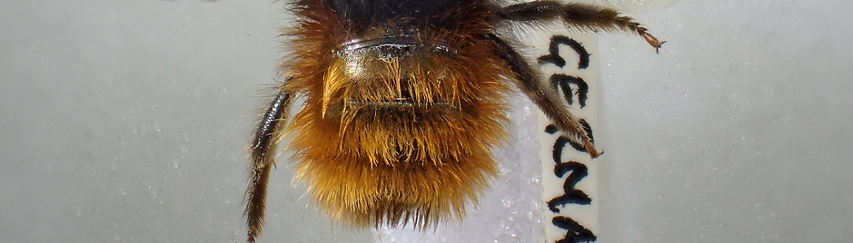
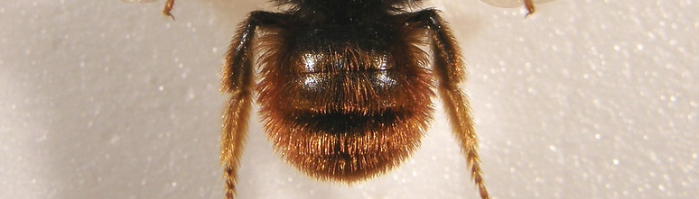
Osmia – Summary
bicornis vs cornuta:
O. bicornis females have greyish, light-colored hair on the dorsal part of the thorax and yellow/orange hair on the abdomen. They have a black tip at the end of the abdomen.
O. cornuta females have a black-haired thorax and their abdomen has a brighter red color than O. bicornis.
bicolor:
females look like cornuta but are smaller(<1cm), shorter haired (you see more of the black tergite), have no facial horns, and usually nests in empty snail shells.

Slide 12
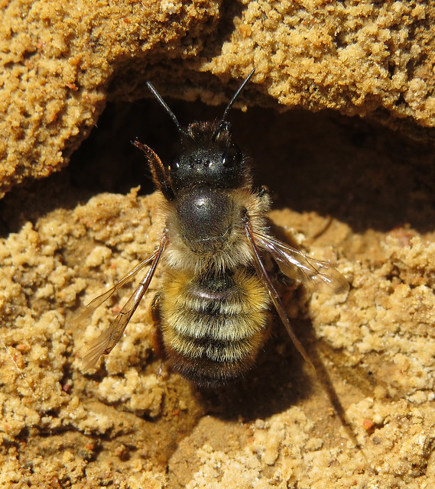
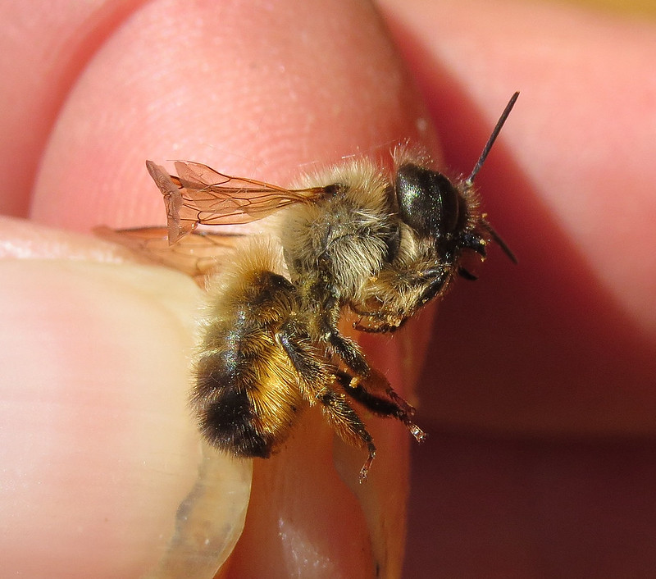
Osmia - Quiz

Slide 13
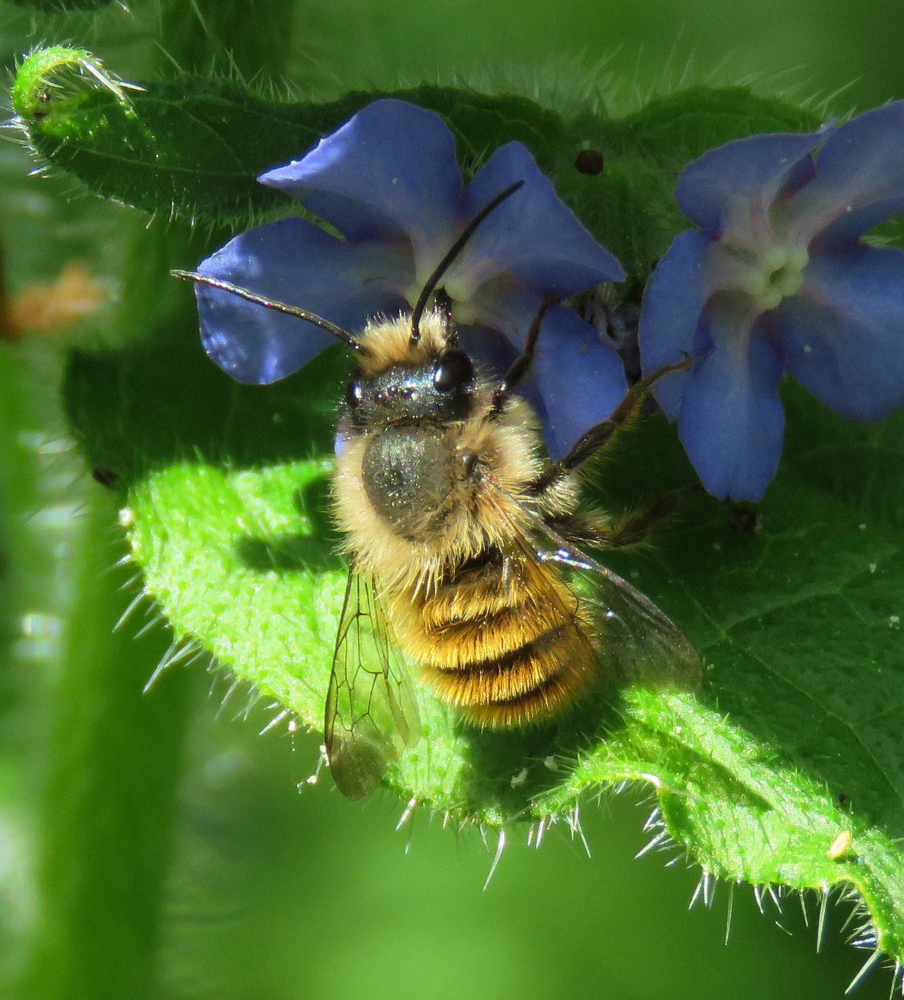
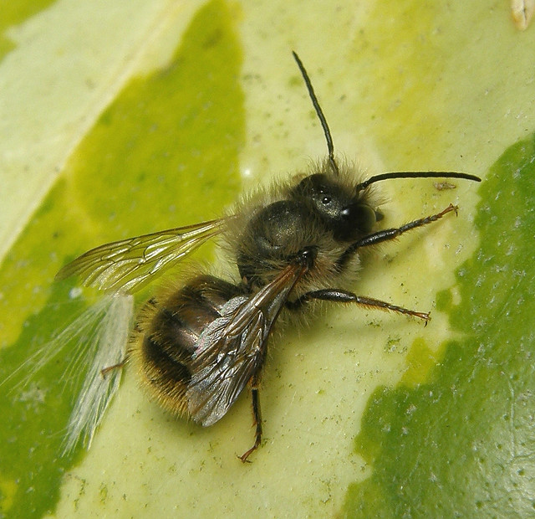
Osmia - Quiz

Slide 14
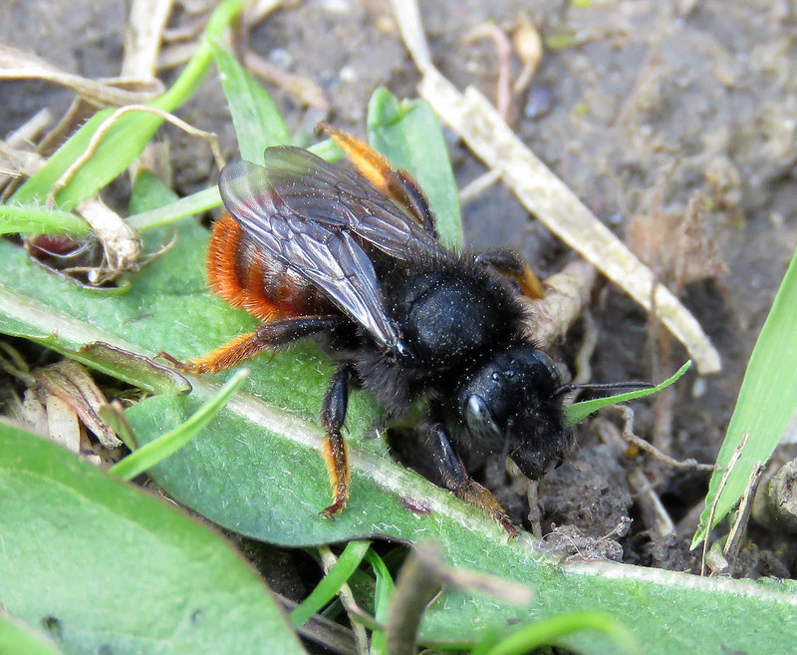
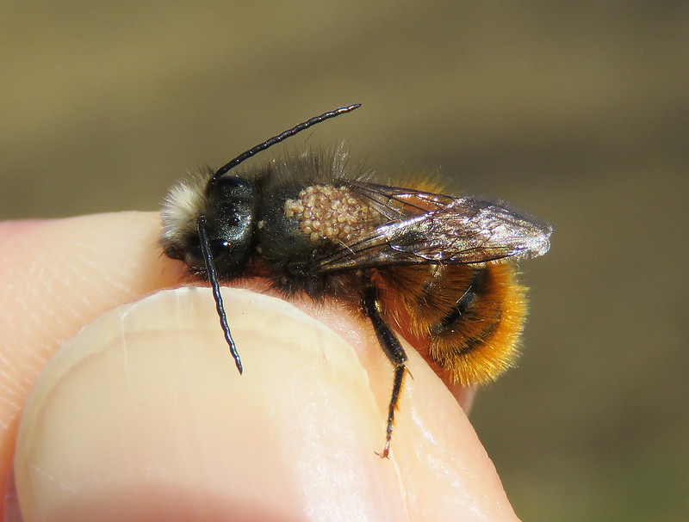
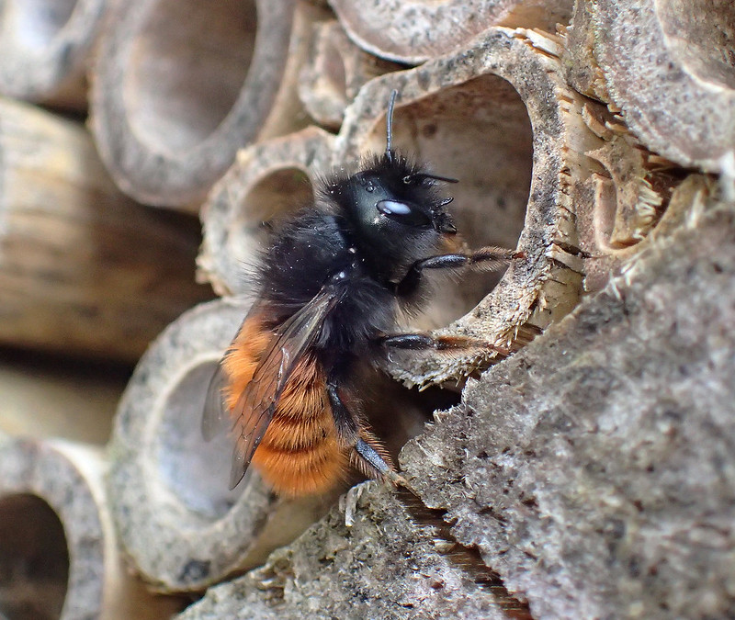
Osmia - Quiz

Slide 15
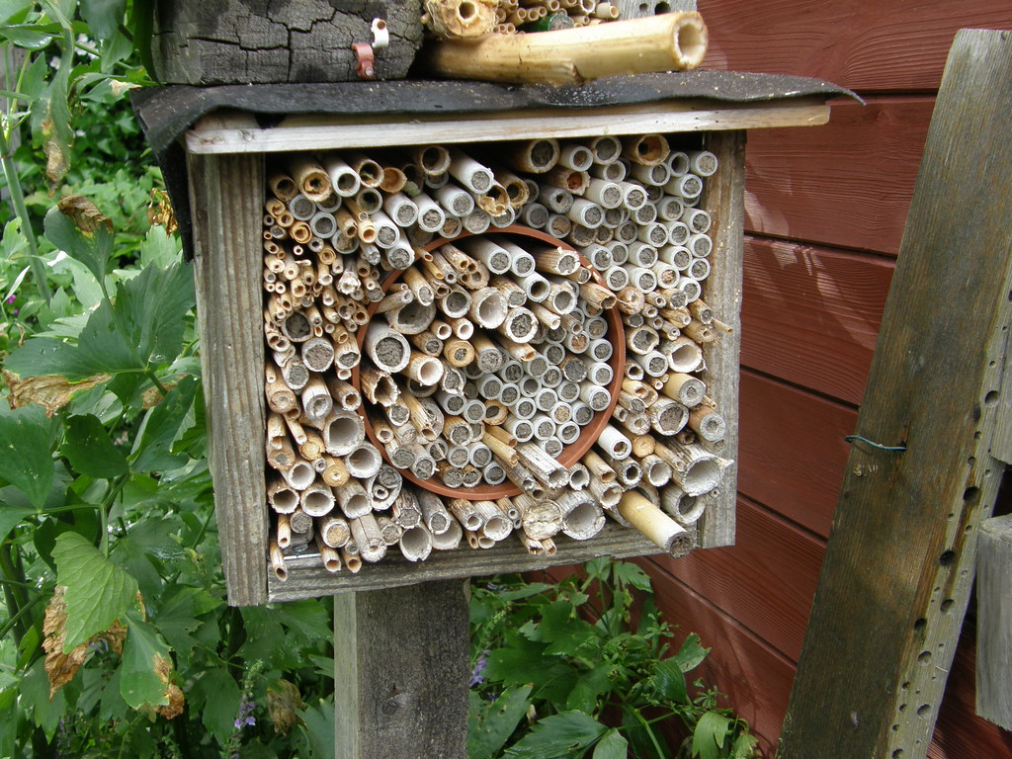
Osmia – Where to find them?
Other spots:
Cracks in walls
Holes in plastering
Drainage pipes
Cracks in window frames
Recesses in stones
Old nests of fur bees
Key holes
Empty snail shells (occasional)
Empty plant stems
Empty beetle hollows
Sandy banks
Old-mortared walls
They need moist soil/mud to close their nests.

Slide 16
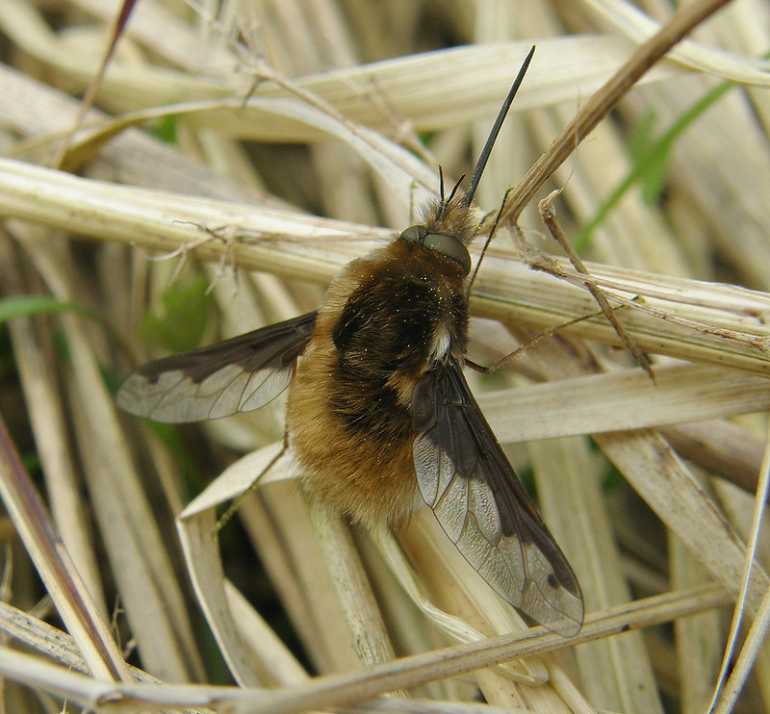
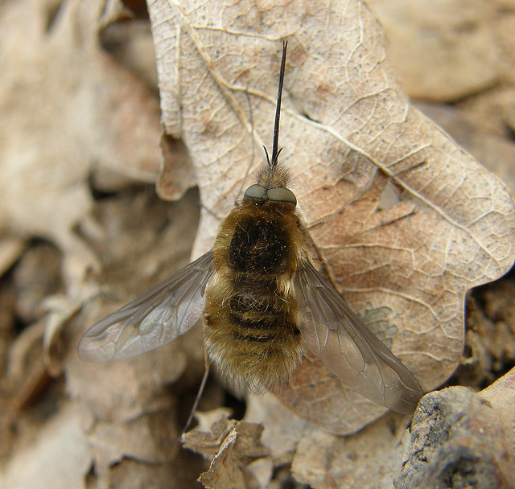
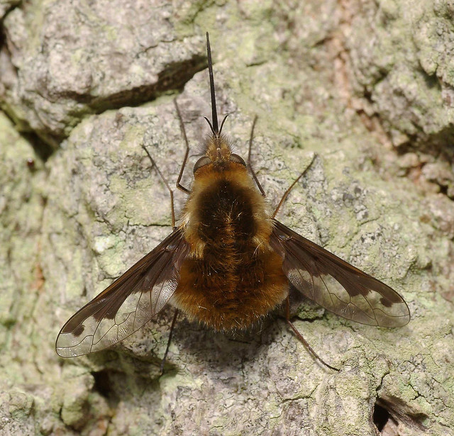
Bombylius major
Adults may bask on dead leaves and bare ground
Males hover above our heads
Can be found close to Andrena sp. nests

Slide 17
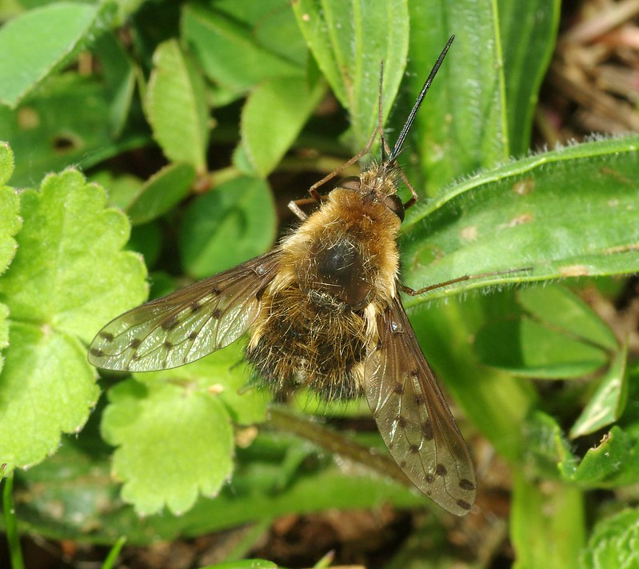
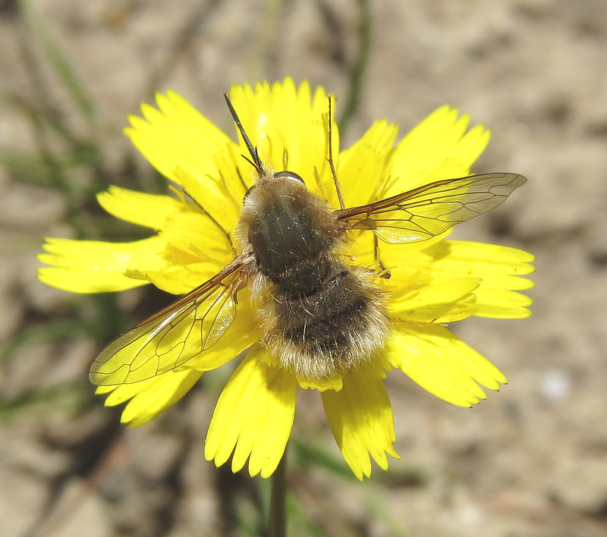
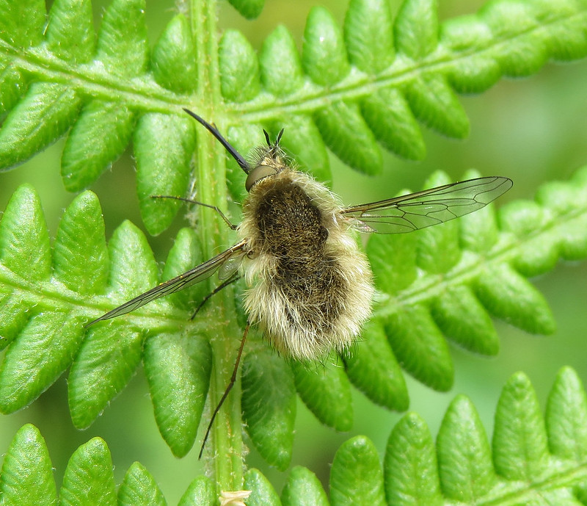
Bombylius major – Potential confusion
Other beeflies have either transparent wings or dotted wings

Slide 18
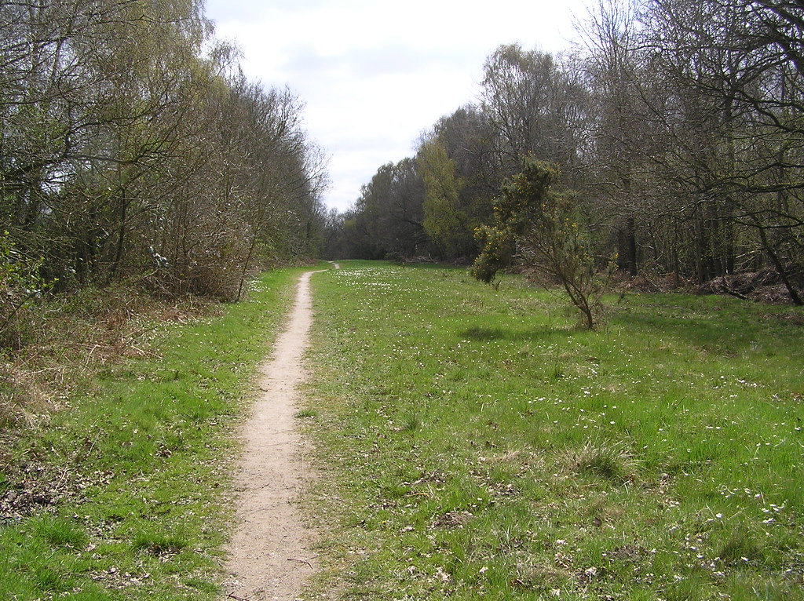
Bombylius major – Where to find them
Adults may bask on dead leaves and bare ground
Males hover above our heads
Can be found close to Andrena sp. nests

Slide 19
Safety on the field
Fieldwork is generally safe.
If you prefer to sample in pairs, especially for remote or sketchy areas, that is totally fine. Try to sample at least 30m from each other when on site.
If your sampling site is close to a road, please wear a yellow or orange safety vest.
If a guard bothers you without being threatening, call us:
Julian (+33749685394) and Alain (+352…)

Slide 20
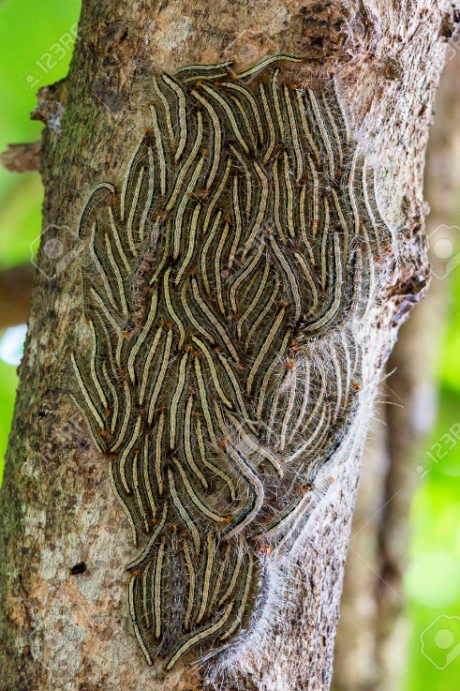
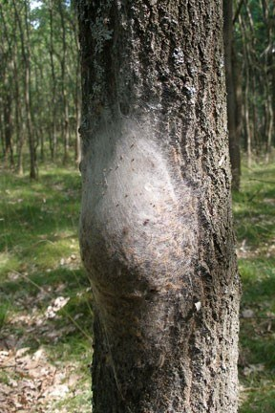
Safety on the field
Be careful about areas infested with oak processionary, avoid them and downwind areas on windy days. Wear pants not shorts if covering forested areas.
Some dogs and horses may become quite nervous because of the net, slowly put the net down until they are gone.
Absolutely avoid eye-contact with stray dogs.

Slide 21
Final piece of advice
Learn a

